Slide 1
Mapping a Conceptual Design into a Logical Design
Lecture 5

Slide 2

Steps to Convert ER/EER → Relational
ER-to-Relational Mapping Algorithm
Step 1: Mapping of Regular Entity Types
Step 2: Mapping of Weak Entity Types
Step 3: Mapping of Binary 1:1 Relation Types
Step 4: Mapping of Binary 1:N Relationship Types
Step 5: Mapping of Binary M:N Relationship Types Step 6: Mapping of Multivalued attributes
Step 7: Mapping of N-ary Relationship Types
Mapping EER Model Constructs to Relations
Step 8: Options for Mapping Specialization or Generalization
Step 9: Mapping of Union Types (Categories)

Slide 3

Example COMPANY Database
The company is organized into DEPARTMENTs. Each department has a name, number and an employee who manages the department. We keep track of the start date of the department manager.
Each department controls a number of PROJECTs. Each project has a name, number and is located at a single location.

Slide 4
Example COMPANY Database (Cont.)
We store each EMPLOYEE’s social security number, address, salary, sex, and birthdate. Each employee works for one department but may work on several projects. We keep track of the number of hours per week that an employee currently works on each project. We also keep track of the direct supervisor of each employee.
Each employee may have a number of DEPENDENTs. For each dependent, we keep track of their name, sex, birthdate, and relationship to employee.

Slide 5
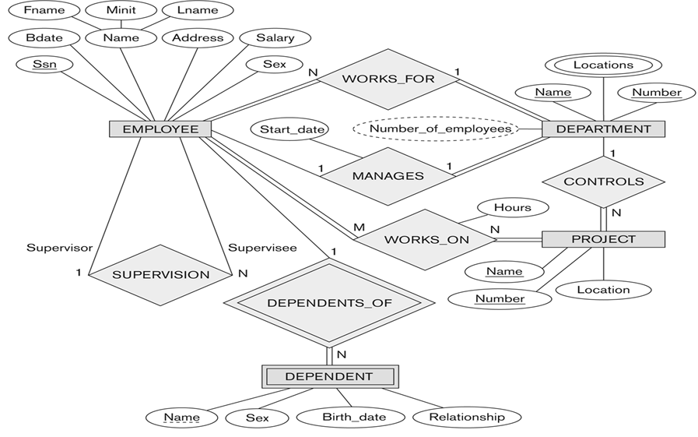
ER Diagram – Company database

Slide 6

ER-to-Relational Mapping Algorithm
Step 1: Mapping of Regular Entity Types.
For each regular (strong) entity type E in the ER schema, create a relation R that includes all the simple attributes of E. Choose one of the key attributes of E as the primary key for R. If the chosen key of E is composite, the set of simple attributes that form it will together form the primary key of R.
Example: Create the relations EMPLOYEE, DEPARTMENT, and PROJECT in the relational schema corresponding to the regular entities in the ER diagram. SSN, DNUMBER, and PNUMBER are the primary keys for the relations EMPLOYEE, DEPARTMENT, and PROJECT.

Slide 7
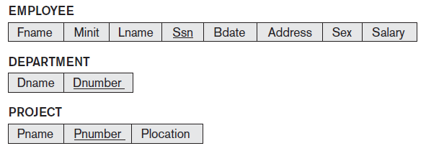

Output
Result after Step1: Mapping of Regular Entity Types.

Slide 8

ER-to-Relational Mapping Algorithm (Cont.)
Step 2: Mapping of Weak Entity Types
For each weak entity type W in the ER schema with owner entity type E, create a relation R and include all simple attributes (or simple components of composite attributes) of W as attributes of R.
In addition, include as foreign key attributes of R the primary key attribute(s) of the relation(s) that correspond to the owner entity type(s).
The primary key of R is the combination of
the primary key(s) of the owner(s) and the
partial key of the weak entity type W, if any.

Slide 9

Example – Mapping Weak Entities
Create the relation DEPENDENT to correspond to the weak entity type DEPENDENT. Include the primary key SSN of the EMPLOYEE relation as a foreign key attribute of DEPENDENT (renamed to ESSN).
The primary key of the DEPENDENT relation is the combination
{ESSN, DEPENDENT_NAME} because DEPENDENT_NAME is the partial key of DEPENDENT

Slide 10

ER-to-Relational Mapping Algorithm (Cont.)
Step 3: Mapping of Binary 1:1 Relationship Types
For each binary 1:1 relationship type R in the ER schema, identify the relations S and T that correspond to the entity types participating in R. There are three possible approaches:
Foreign Key Approach: Choose one of the relations – say S, and include a foreign key in S the primary key of T. It is better to choose an entity type with total participation in R in the role of S.

Slide 11
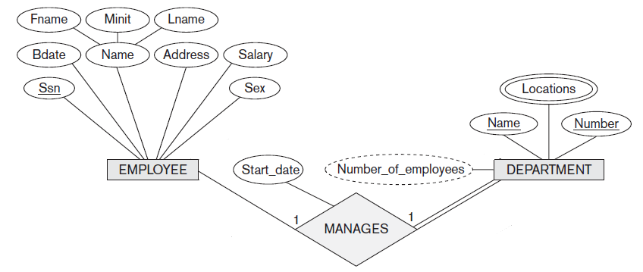

Example - Mapping of Binary 1:1 Relationship
Foreign Key Approach
1:1 relation MANAGES is mapped by choosing the participating entity type DEPARTMENT to serve in the role of S, because its participation in the MANAGES relationship type is total.

Slide 12
ER-to-Relational Mapping Algorithm (Cont.)
Merged Relation Option: An alternate mapping of a 1:1 relationship type is possible by merging the two entity types and the relationship into a single relation. This may be appropriate when both participations are total.
Cross-reference or Relationship Relation Option: The third alternative is to set up a third relation R for the purpose of cross-referencing the primary keys of the two relations S and T representing the entity types. Required for binary M:N relationships
EMPLOYEE
WORKS_ON
PROJECT

Slide 13

ER-to-Relational Mapping Algorithm (Cont.)
Step 4: Mapping of Binary 1:N Relationship Types.
For each regular binary 1:N relationship type R, identify the relation S that represent the participating entity type at the N-side of the relationship type.
Include as foreign key in S the primary key of the relation T that represents the other entity type participating in R.
Include any simple attributes of the 1:N
relation type as attributes of S.

Slide 14
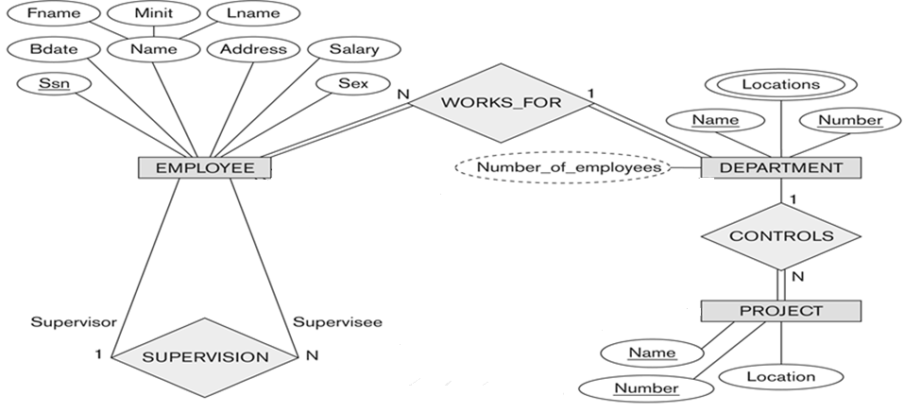

Example - Mapping of Binary 1:N Relationship – WORKS_FOR, CONTROLS, and SUPERVISION.
Notes:
For WORKS_FOR we include the primary key Dnumber of the DEPARTMENT relation as foreign key in the EMPLOYEE relation and call it Dno. For SUPERVISION we include the primary key of the EMPLOYEE relation as foreign key in the EMPLOYEE relation itself—because the relationship is recursive— and call it Super_ssn. The CONTROLS relationship is mapped to the foreign key attribute Dnum of PROJECT, which references the primary key Dnumber of the DEPARTMENT relation.

Slide 15
ER-to-Relational Mapping Algorithm (Cont.)
Step 5: Mapping of Binary M:N Relationship Types.
For each regular binary M:N relationship type R, create a new relation S to represent R.
Include as foreign key attributes in S the primary keys of the relations that represent the participating entity types; their combination will form the primary key of S.
Also include any simple attributes of the M:N relationship type (or simple components of composite attributes) as attributes of S.

Slide 16
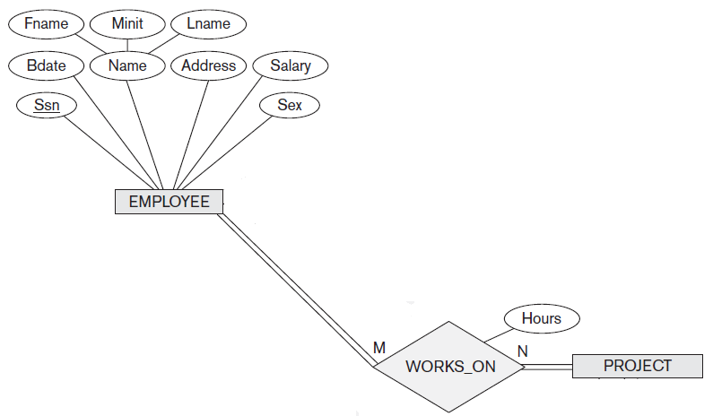

Example - Mapping of Binary M:N Relationship
Notes:
The M:N relationship type WORKS_ON from the ER diagram is mapped by creating a relation WORKS_ON in the relational database schema. The primary keys of the PROJECT and EMPLOYEE relations are included as foreign keys in WORKS_ON and renamed PNO and ESSN, respectively.
Attribute HOURS in WORKS_ON represents the HOURS attribute of the relation type. The primary key of the WORKS_ON relation is the combination of the foreign key attributes {ESSN, PNO}.

Slide 17

ER-to-Relational Mapping Algorithm (Cont.)
Step 6: Mapping of Multivalued attributes.
For each multivalued attribute A, create a new relation R. This relation R will include an attribute corresponding to A, plus the primary key attribute K-as a foreign key in R-of the relation that represents the entity type of relationship type that has A as an attribute.
The primary key of R is the combination of A and K. If the multivalued attribute is composite, we include its simple components.

Slide 18

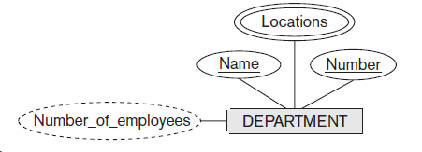
Example - Mapping of Multivalued attributes
Notes:
The relation DEPT_LOCATIONS is created. The attribute DLOCATION represents the multivalued attribute LOCATIONS of DEPARTMENT, while DNUMBER-as foreign key-represents the primary key of the DEPARTMENT relation. The primary key of R is the combination of {DNUMBER, DLOCATION}.

Slide 19

ER-to-Relational Mapping Algorithm (Cont.)
Step 7: Mapping of N-ary Relationship Types
For each n-ary relationship type R, where n>2, create a new relationship S to represent R.
Include as foreign key attributes in S the
primary keys of the relations that
represent the participating entity types.
Also include any simple attributes of
the n-ary relationship type (or simple
components of composite attributes) as
attributes of S.

Slide 20
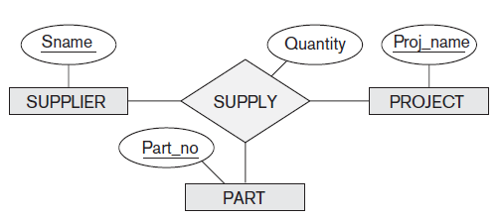
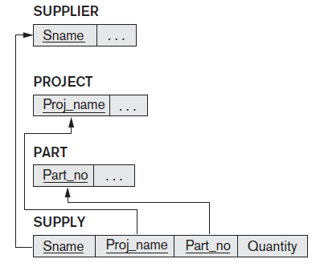
Example - Mapping of N-ary Relationship
Notes:
The relationship type SUPPY in the ER can be mapped to the relation SUPPLY shown in the relational schema, whose primary key is the combination of the three foreign keys {SNAME, PARTNO, PROJNAME}

Slide 21
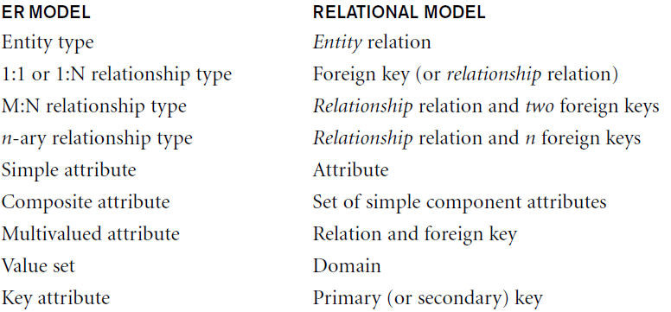
Summary of Mapping ER Model Constructs

Slide 22
ER Diagram – Company database

Slide 23
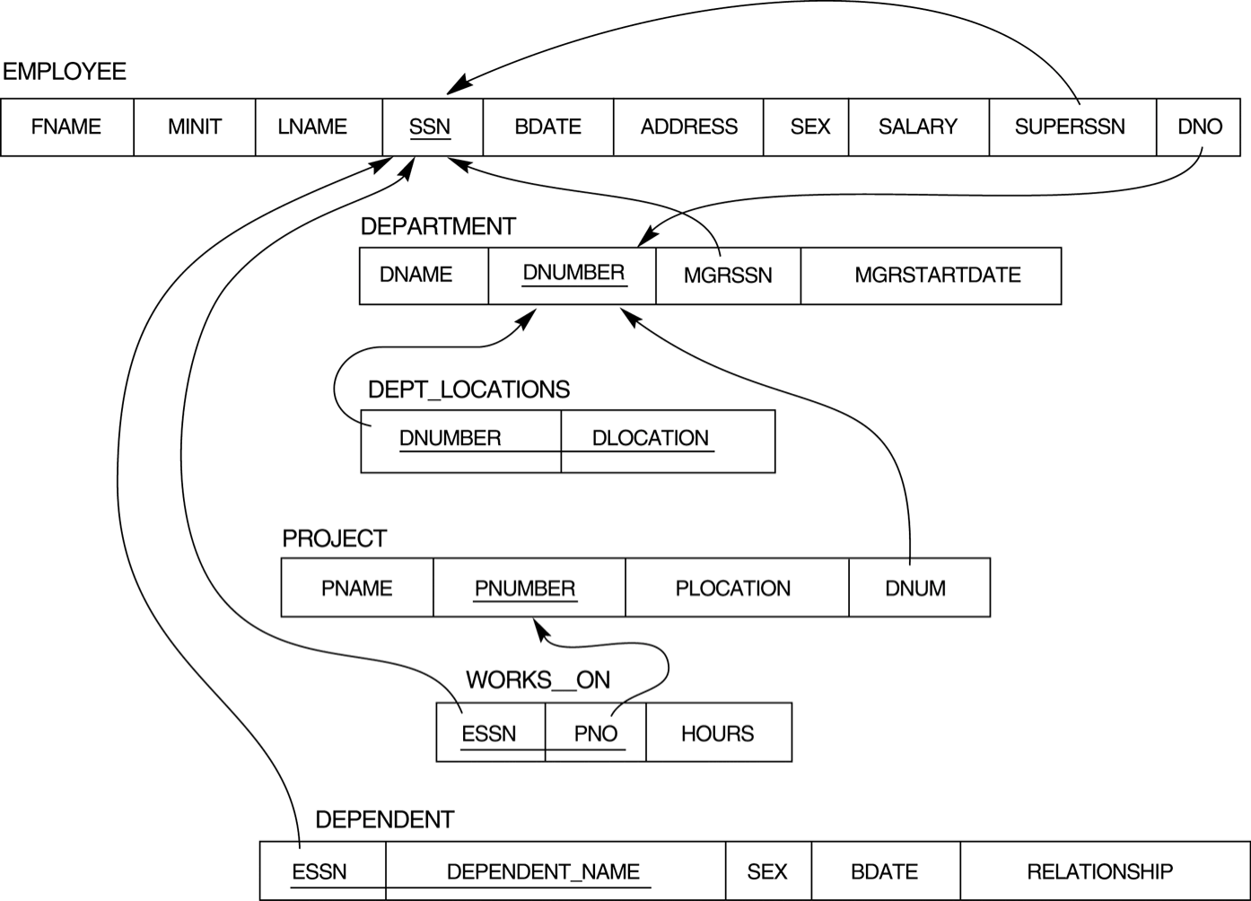
Final Mapping of COMPANY ER Model to Relational Schema

Slide 24

Mapping EER Model Constructs to Relations
Step 8: Options for Mapping Specialization or Generalization.
Convert each specialization with m subclasses {S₁, S₂,….,S_{m}} and generalized superclass C, where the attributes of C are {k,a₁,…a_{n}} and k is the (primary) key, into relational schemas using one of the four following options:

Slide 25
8A: Options for Mapping Specialization/ Generalization
8A: Multiple relations-Superclass and subclasses.
Create a relation L for C with attributes Attrs(L) = {k,a₁,…a_{n}} and PK(L) = k. Create a relation L_{i} for each subclass S_{i}, 1 < i < m, with the attributesAttrs(L_{i}) = {k} U {attributes of S_{i}} and PK(L_{i})=k.
This option works for any specialization (total or partial, disjoint of over-lapping).

Slide 26
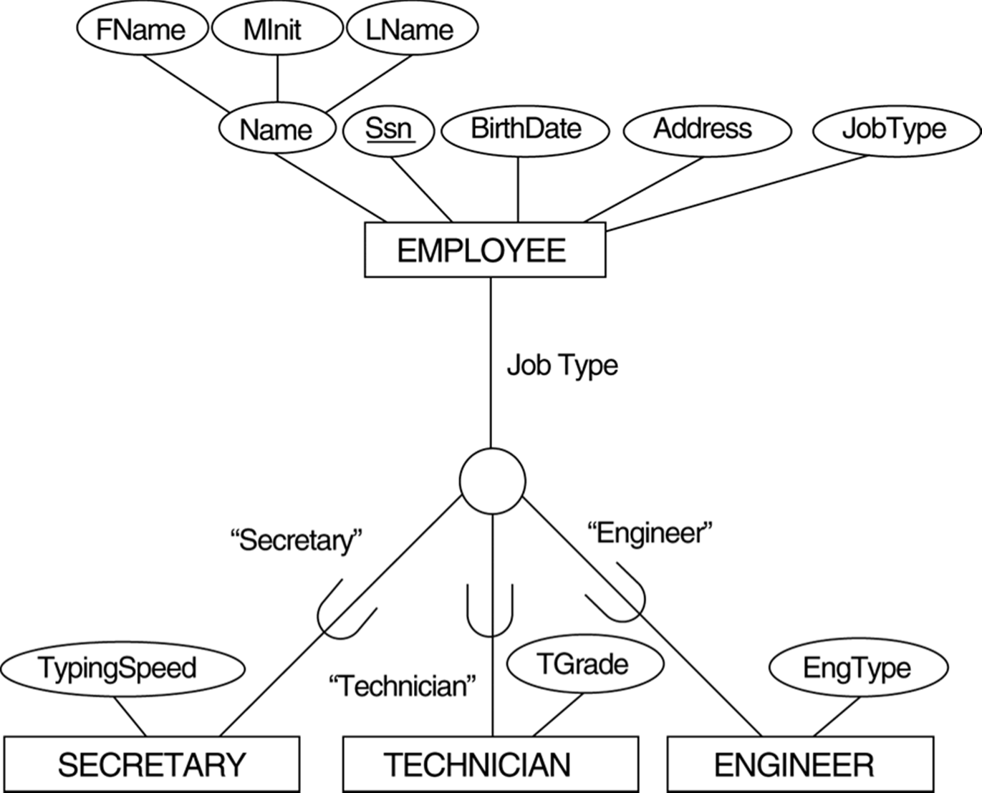
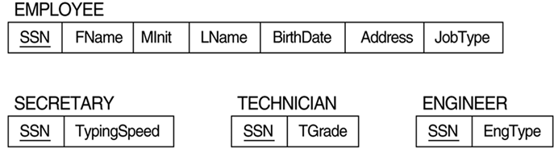
Example
EER diagram notation for an attribute- defined specialization on JobType.

Slide 27

8B: Options for Mapping Specialization/ Generalization
8B: Multiple relations-Subclass relations only
Create a relation L_{i} for each subclass S_{i}, 1 < i < m, with the attributes Attr(L_{i}) = {attributes of S_{i}} U {k,a₁…,a_{n}} and PK(L_{i}) = k.
This option only works for a specialization whose subclasses are total (every entity in the superclass must belong to (at least) one of the subclasses).

Slide 28
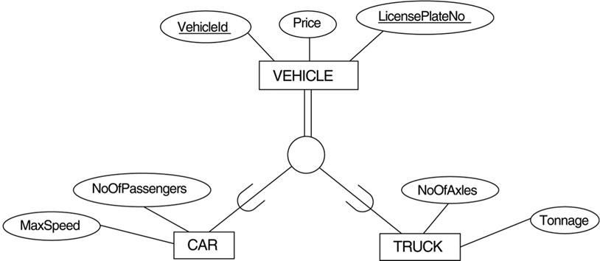
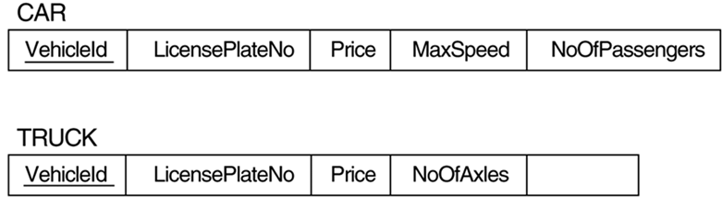
Example

Slide 29
8C: Options for Mapping Specialization/ Generalization
8C: Single relation with one type attribute.
Create a single relation L with attributes Attrs(L) = {k,a₁,…a_{n}} U {attributes of S₁} U…U {attributes of S_{m}} U {t} and PK(L) = k. The attribute t is called a type (or discriminating) attribute that indicates the subclass to which each tuple belongs

Slide 30
Example
EER diagram notation for an attribute - defined specialization on JobType.

Slide 31
8D: Options for Mapping Specialization/ Generalization
8D: Single relation with multiple type attributes.
Create a single relation schema L with attributes Attrs(L) = {k,a₁,…a_{n}} U{attributes of S₁} U…U {attributes of S_{m}} U {t₁, t₂,…,t_{m}} and PK(L) = k.
Each t_{i}, 1 < I < m, is a Boolean type attribute indicating whether a tuple belongs to the subclass S_{i}.

Slide 32
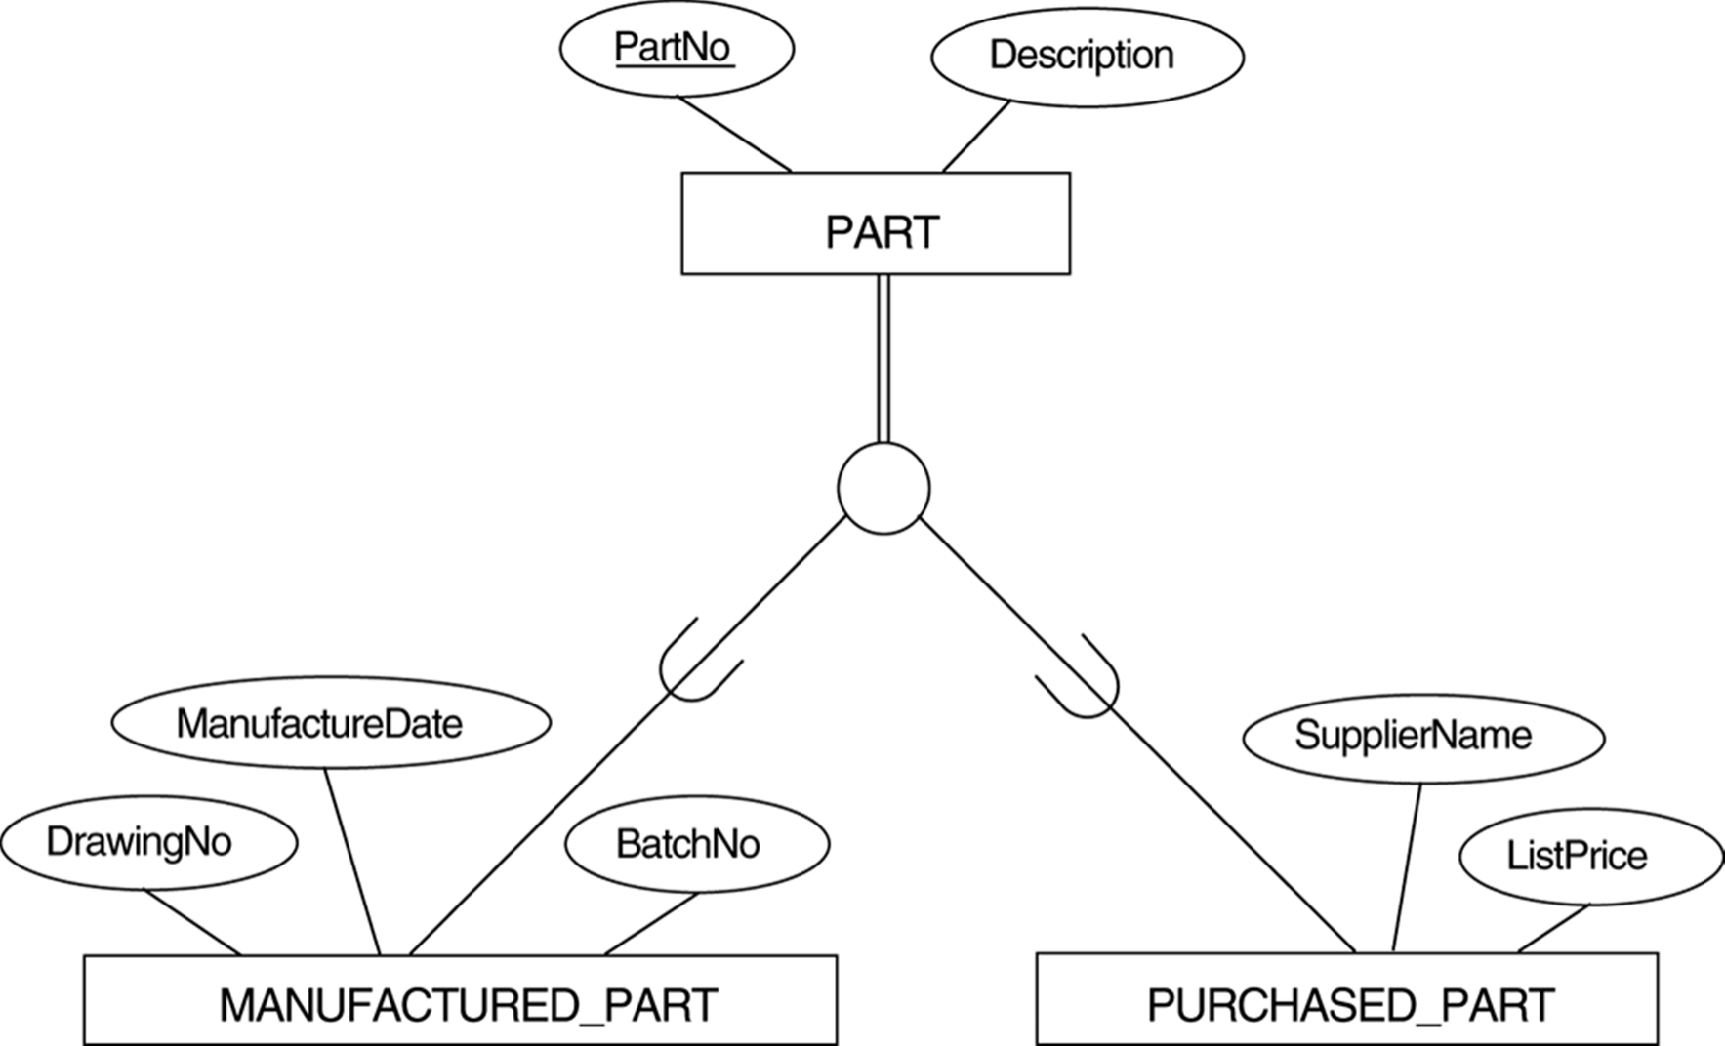
Example
EER diagram notation for an overlapping (non-disjoint) specialization.

Slide 33
Mapping EER Model Constructs to Relations (Cont.)
Mapping of Shared Subclasses (Multiple Inheritance)
A shared subclass, such as STUDENT_ASSISTANT, is a subclass of several classes, indicating multiple inheritance. These classes must all have the same key attribute; otherwise, the shared subclass would be modeled as a category.
Can apply any of the options discussed in Step 8 to a shared subclass, subject to the restriction discussed in Step 8 of the mapping algorithm.

Slide 34
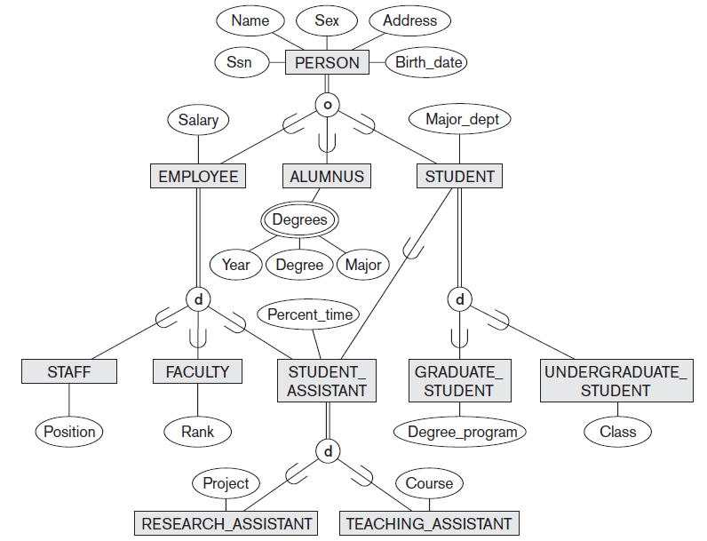
Example – Shared Subclass
A specialization lattice with multiple inheritance for a UNIVERSITY
database.

Slide 35
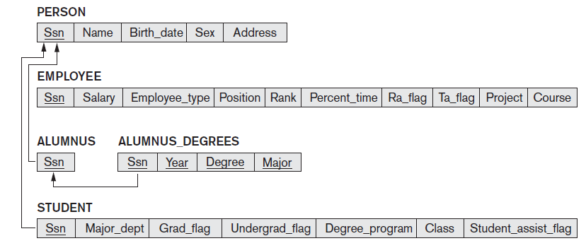
Example – Shared Subclass Solution

Slide 36

Mapping EER Model Constructs to Relations (Cont.)
Step 9: Mapping of Union Types (Categories).
For mapping a category whose defining superclass have different keys, it is customary to specify a new key attribute, called a surrogate key, when creating a relation to correspond to the category.

Slide 37
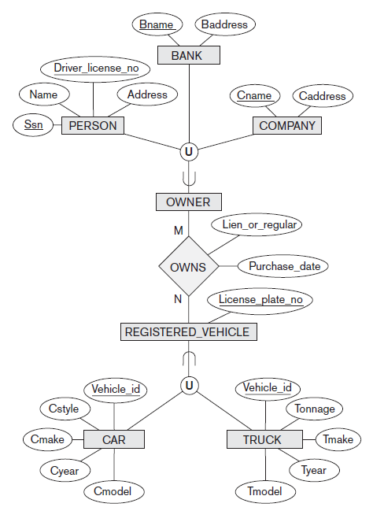
Example: Union (Category)
Two categories (union types): OWNER and REGISTERED_VEHICLE.
Notes:
In the example above, we can create a relation OWNER to correspond to the OWNER category and include any attributes of the category in this relation. The primary key of the OWNER relation is the surrogate key, which we called OwnerId.

Slide 38
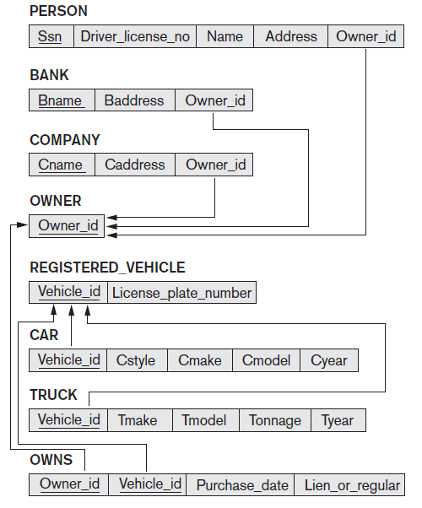
Example: Union (Category) Solution

Slide 39
Thanks!!

